Slide 1


GORDON CONSULTING
Lights, Camera, ROI
A Targeted Path to Film Portfolio Success
PREPARED FOR: LEVELFILM INC.
PAGE 01

Slide 2






GORDON CONSULTING
Challenges in the Film Industry
Market Volatility
Capital Intensiveness
Market Power Dynamics
30%
13%
of films fail to recover their costs
of films hit blockbuster status
Big 5 producers are dominating the market
Our Solution: A customized strategy that will allow levelFILM to successfully predict high earning films while maximizing their resources in a highly competitive market.
PAGE 02

Slide 3









GORDON CONSULTING
Our Model & Analytical Approach
DATA INPUT
SCORING X OPTIMIZER
TARGET SELECTION
Genre
ROI Score
Identify films with strongest ROI potential
Talent
Business
Optimize market & budget
Rules &
Budget
Constraints
Balanced portfolio
Timing
PAGE 03
Box Office Revenue

Slide 4






GORDON CONSULTING
Our Findings - ROI Drivers
BUDGET
Factor into Business Rules & Constraints
Micro (<$5M) & Indie ($5-$20M) budget tiers generated the HIGHEST ROI
Enabling levelFilm to OPTIMIZE BUDGET for highest returns
PAGE 04

Slide 5

GORDON CONSULTING
Our Findings - ROI Drivers
TIMING OF RELEASES
High ROI Periods
Late Spring/Early Summer
Canada Day & Christmas
Factor into Business Rules & Constraints
Positioning levelFilm to OPTIMIZE BUDGET & MARKET TARGETING for highest returns
Genre Performance
Strong seasonality effect genre specific ROIs (i.e. romance in winter season)
PAGE 05

Slide 6

GORDON CONSULTING
Our Findings - ROI Drivers
TALENT
Factor into Business Rules & Constraints
Films that included certain actors & directors generated HIGHER ROI
Equipping levelFilm to OPTIMIZE BUDGET for highest returns
PAGE 06

Slide 7

GORDON CONSULTING
Our Findings - ROI Drivers
DEMOGRAPHIC
INSIGHTS
Factor into Business Rules & Constraints
Empowering levelFilm to DIVERSIFY their portfolio to hedge overall returns
STRONG ROI performance from Hindi & German language films
PAGE 07

Slide 8
GORDON CONSULTING
Recommendation
Leveraging key insights from the model create data-driven business rules & constraints to guide film acquisition. Such as:
Strengthen Business Rule & Constraints Development:
Engage with Subject Matter Experts to validate rules
Continuously refinement based on performance
Demographic Targeting
Seasonal Genre Alignment
Talent & Budget Thresholds
PAGE 08

Slide 9




GORDON CONSULTING
Recommendation
IMPLEMENTATION PLAN
Selecting top 10% of film performers each genre
A/B Test Business Rules to evaluate effectiveness
Performance
Dashboard to monitor ROI across drivers
Evolve Strategy based on iterative data insights
PAGE 09

Slide 10
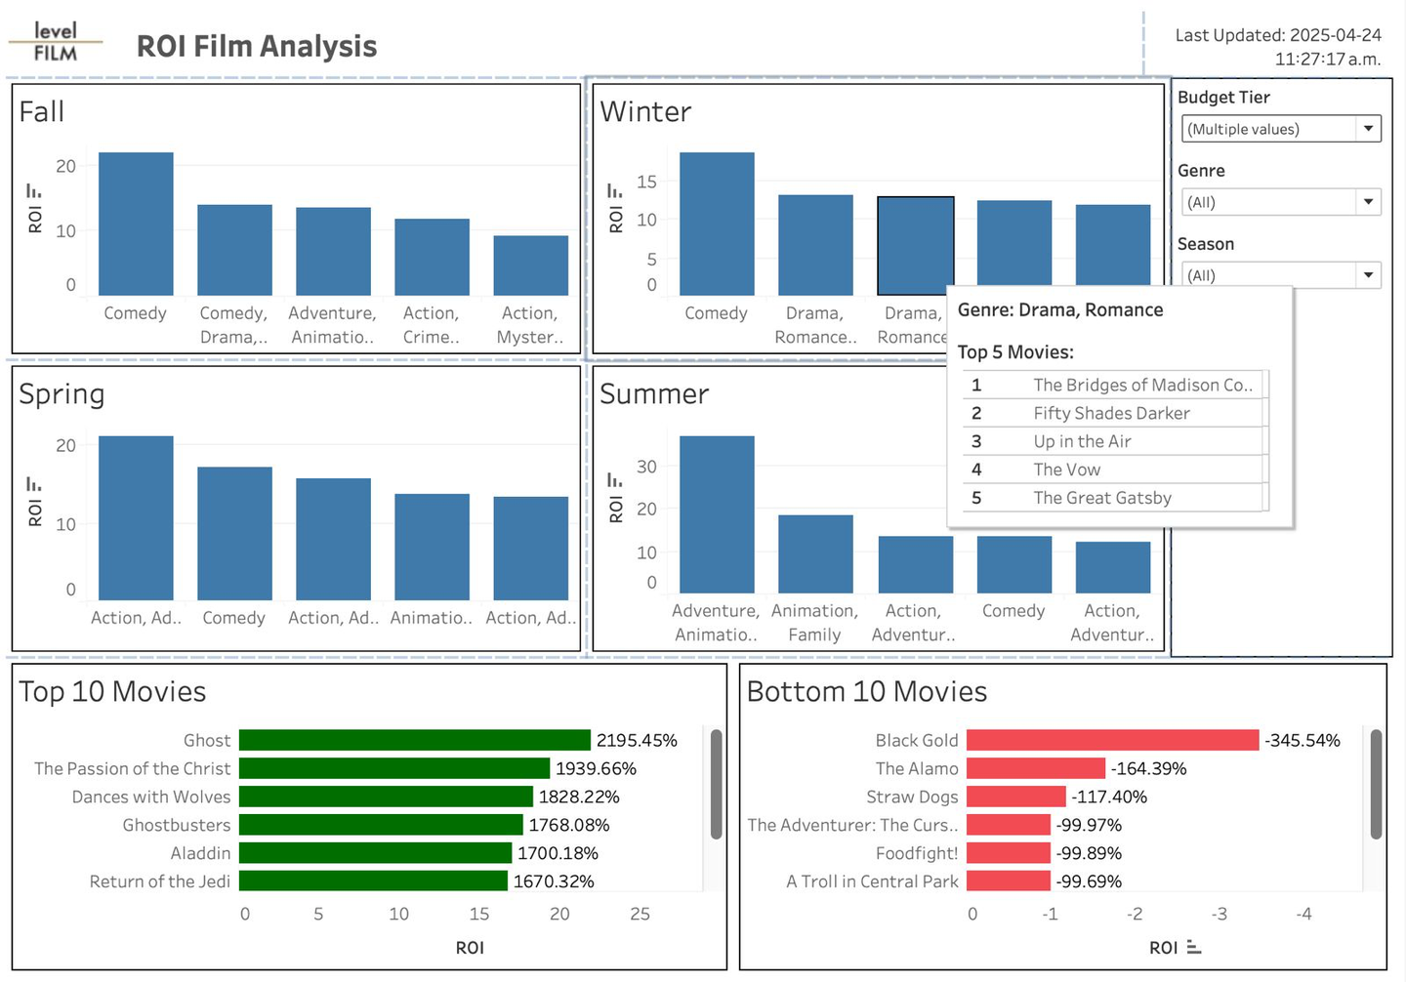
Recommendation
GORDON CONSULTING
DASHBOARD
KPI TARGETS
<10% increase in ROI
Not enough, revise approach to pick up top 5% performers
10-15% increase in ROI
Moderate growth, continue to monitor
>15% increase in ROI
Model is performing strong
PAGE 06
PAGE 10

Slide 11



GORDON CONSULTING
Next Steps
Enabling Visibility Throughout the Process
Adopt a Data-Driven Acquisition Strategy
Formulate Business Rules
Pilot & Scale
Performance
Dashboard
Quarterly
Reviews
Continuous
Learning
PAGE 11

Slide 12
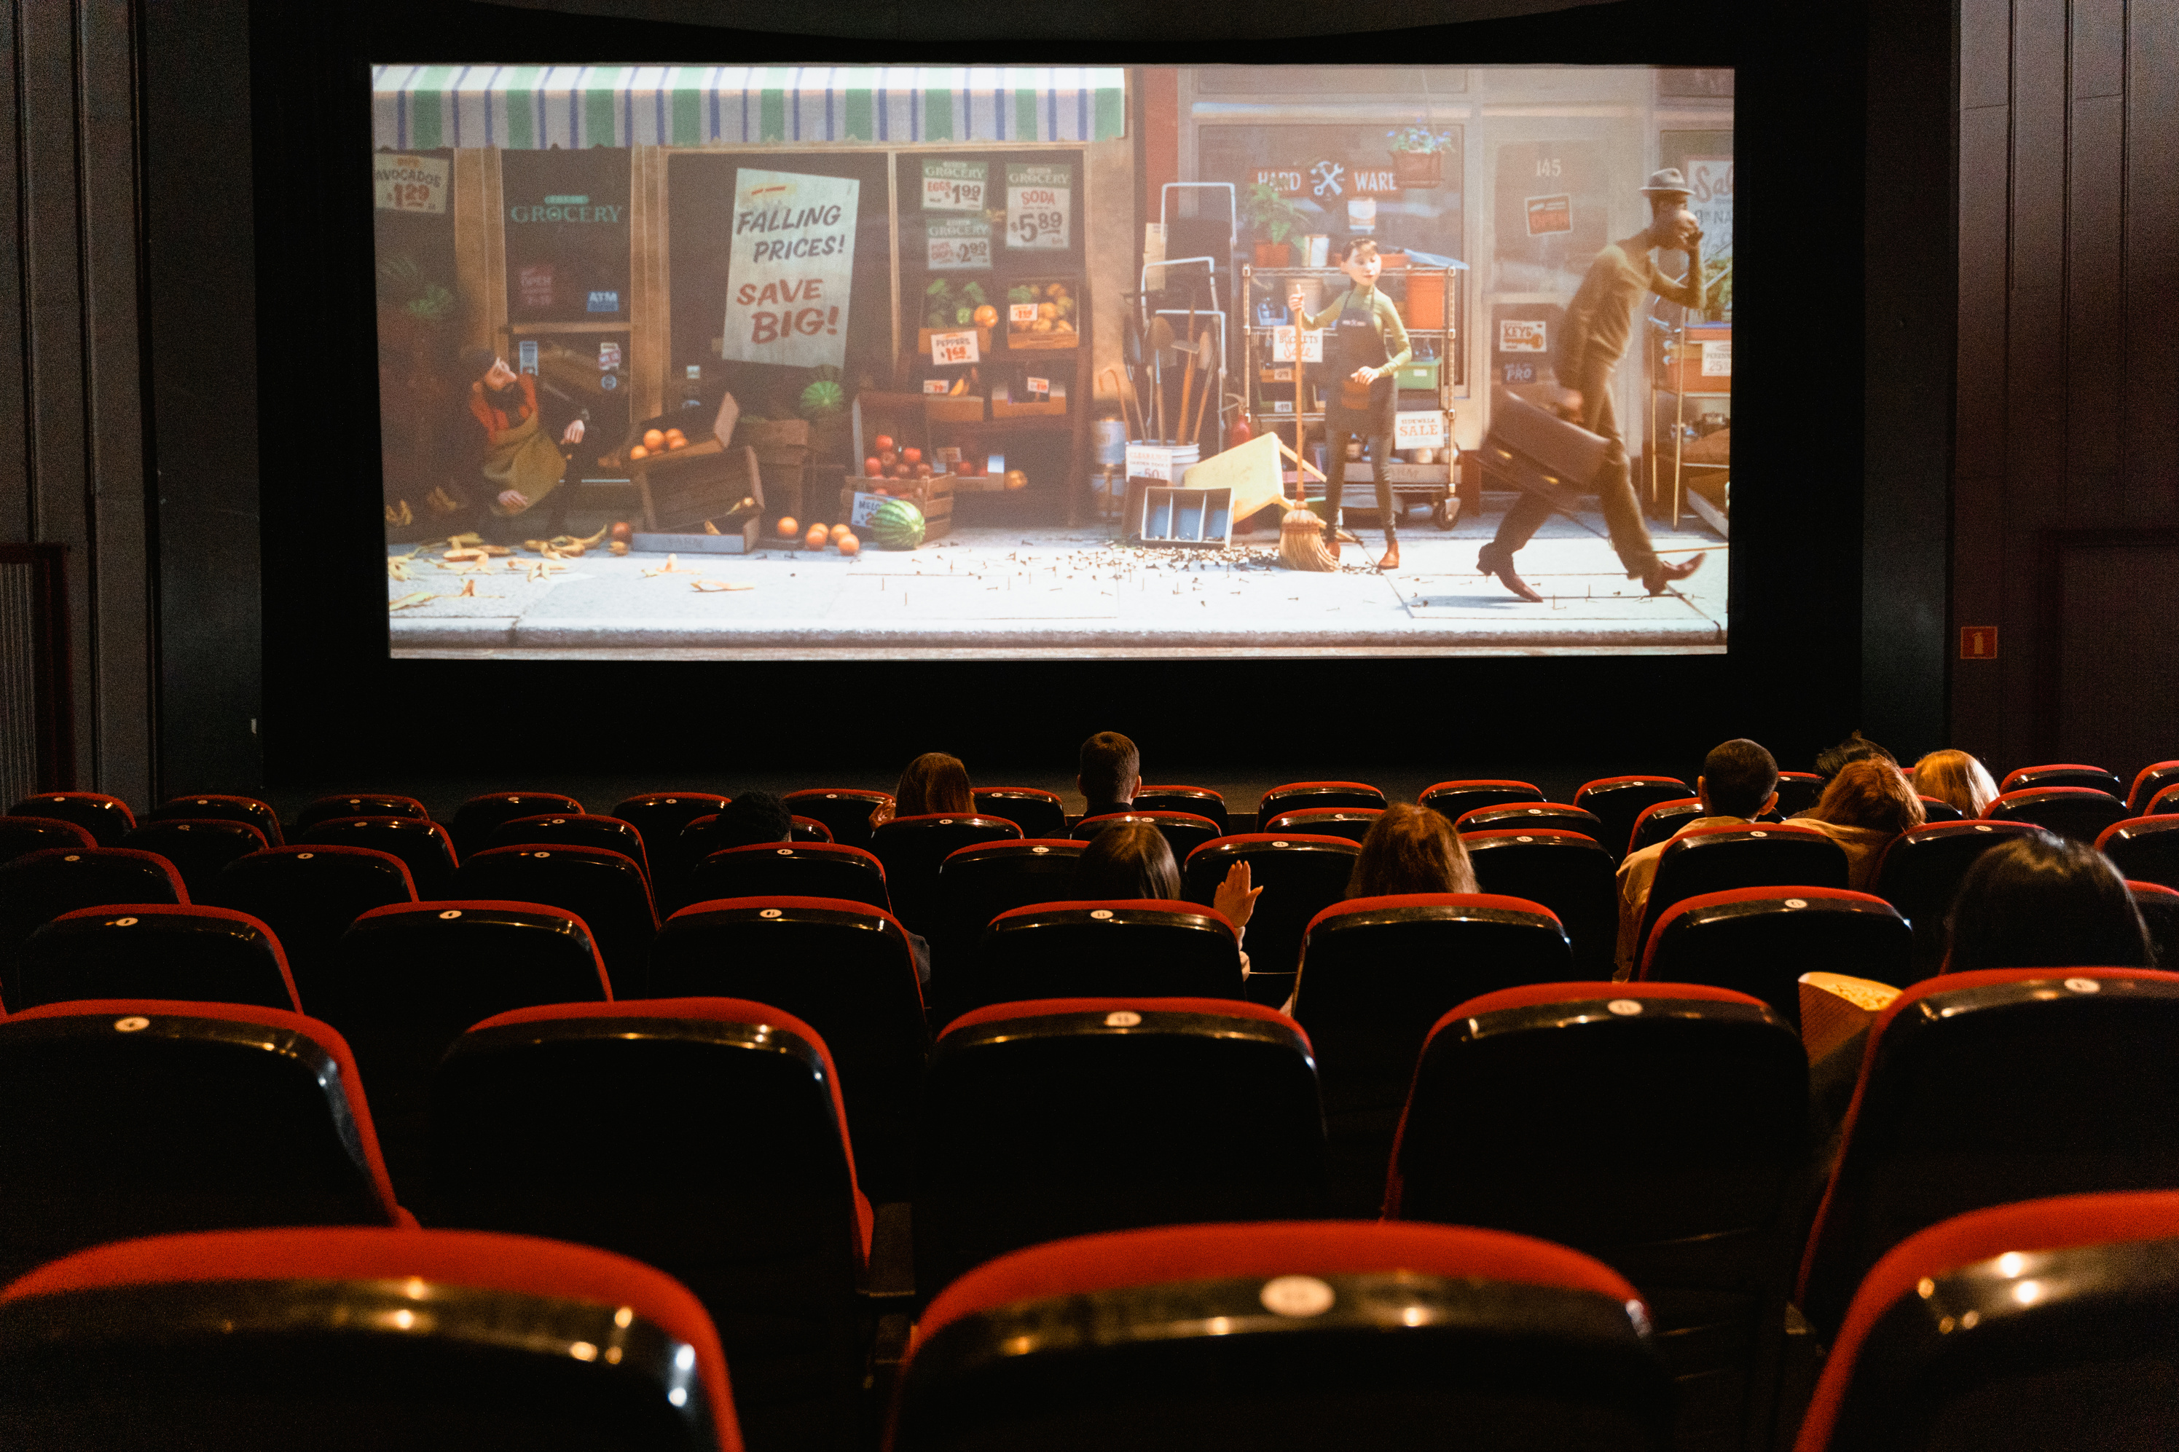


GORDON CONSULTING
Thank You
PAGE 06

Slide 13

GORDON CONSULTING
Appendix

Slide 14
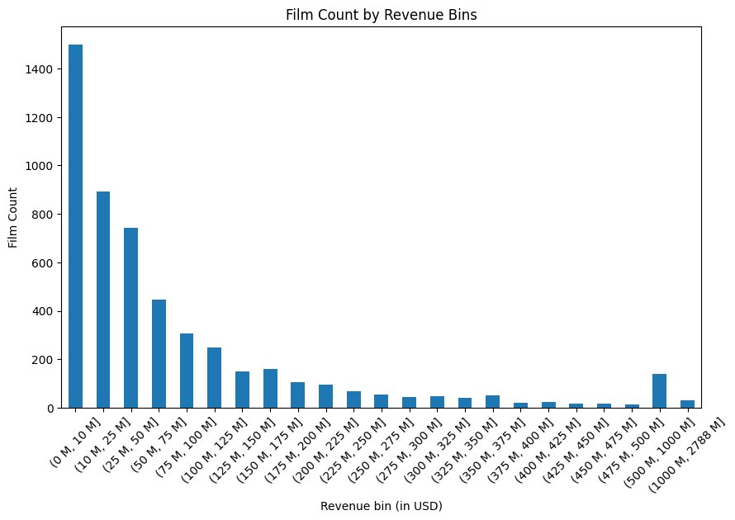
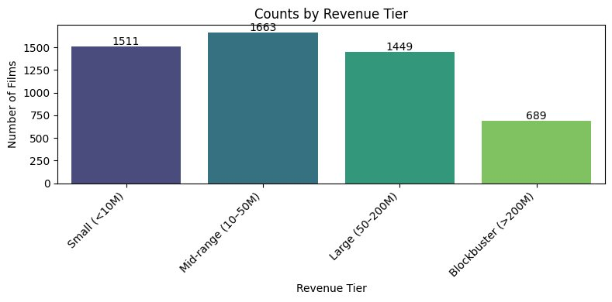
GORDON CONSULTING
Appendix - Revenue Breakdown

Slide 15
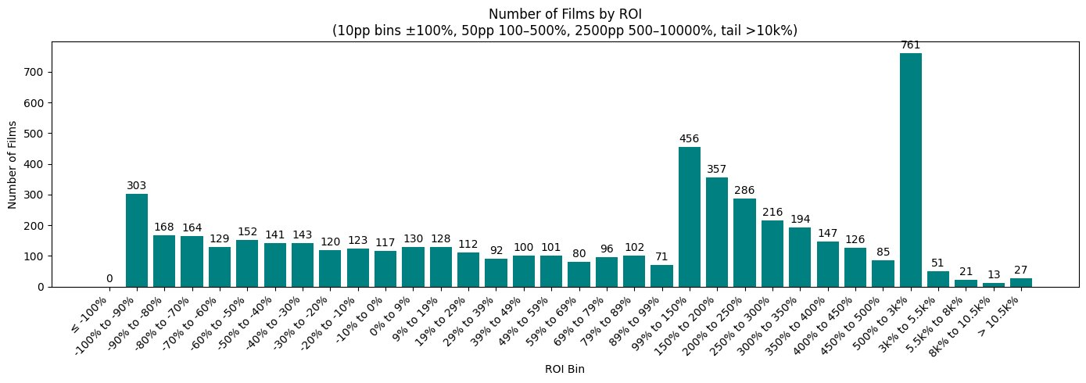
GORDON CONSULTING
Appendix - ROI Breakdown

Slide 16
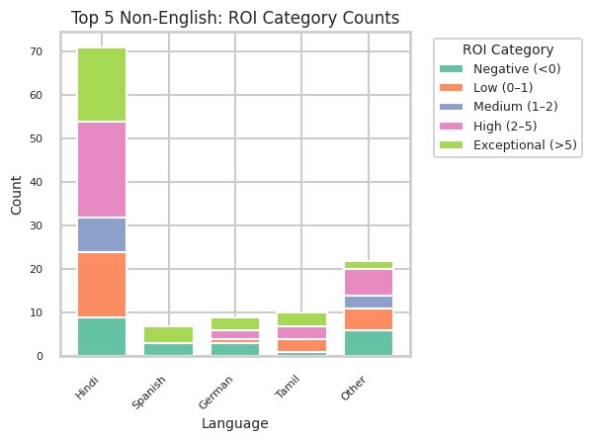
GORDON CONSULTING
Appendix - Other Language Movies

Slide 17
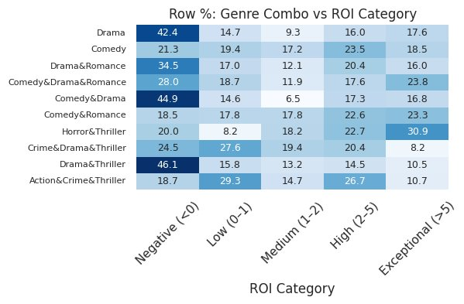
GORDON CONSULTING
Appendix – Genre Combos

Slide 18
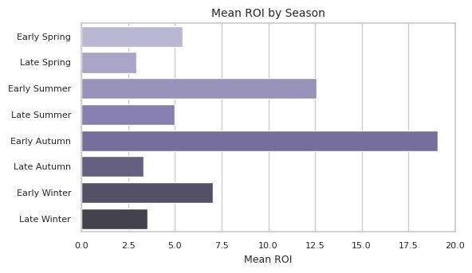
GORDON CONSULTING
Appendix - Seasonality Effect

Slide 19
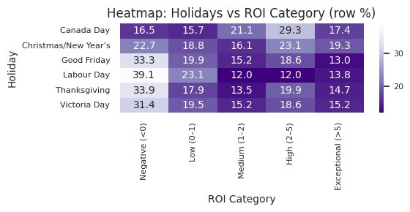
GORDON CONSULTING
Appendix - Holiday Effect

Slide 20
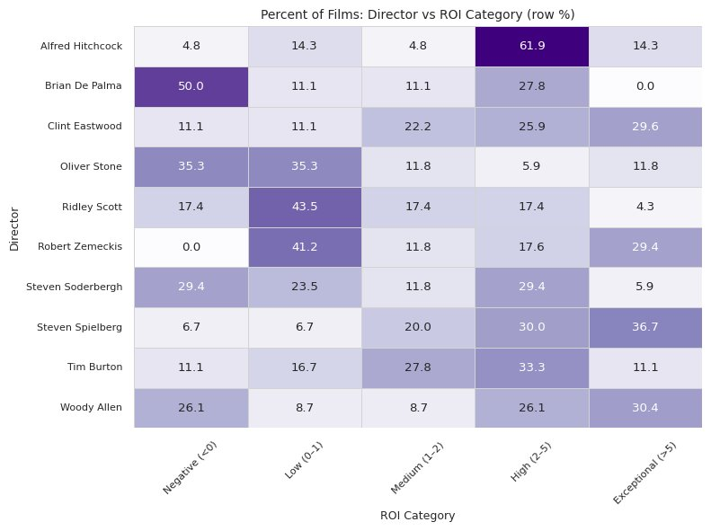
GORDON CONSULTING
Appendix - Directors

Slide 21
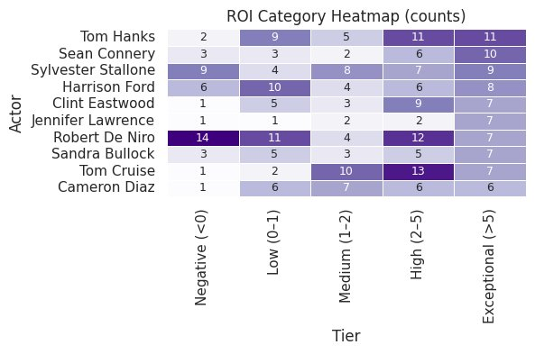
GORDON CONSULTING
Appendix - Actors

Slide 22
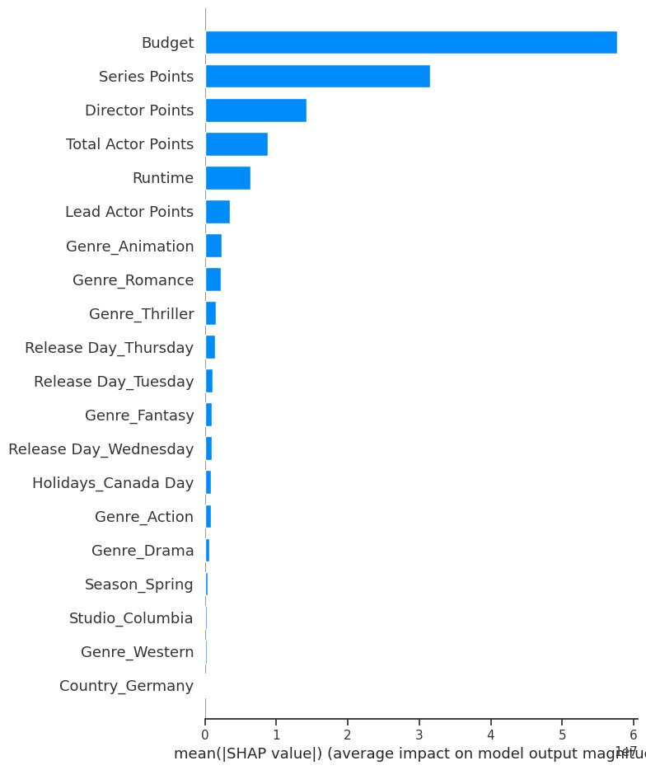
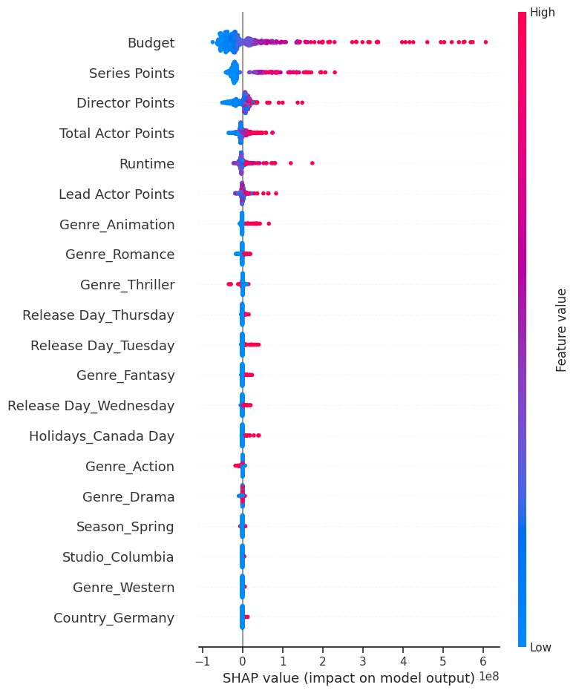
GORDON CONSULTING
Appendix - SHAP & LIME

